Slide 1
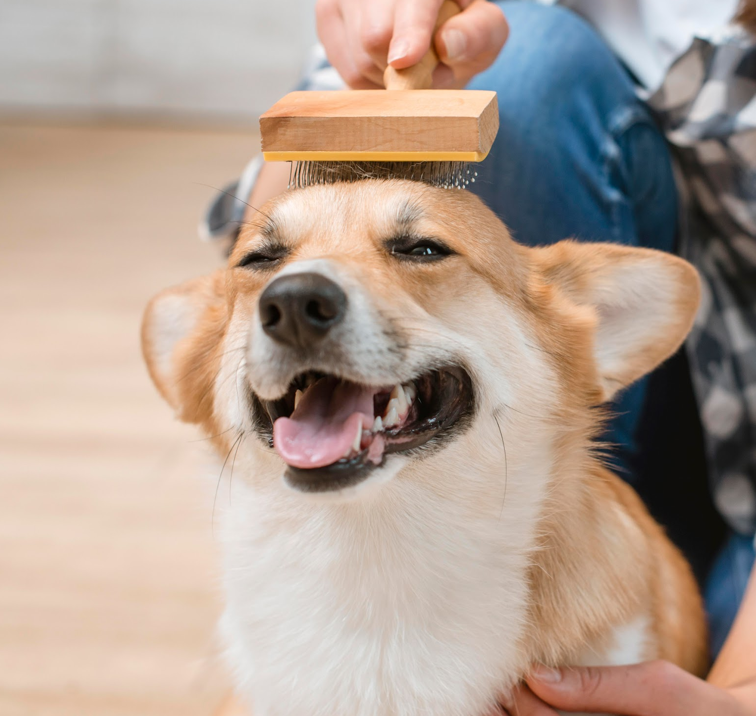
Pet’s Home
Team 2-Fantastic Five:
Chang Li,
Liuyi Chen,
Yuyang Han,
Yihong Liu,
Xiaodan Hu
Fall 2021

Slide 2
Brief Introduction
Team 2
Unmet Needs:
Puppy scam
Inconvenient transport
After-sales guarantee
Customer segments:
Potential Pet Buyers
Breeders
Fall 2021

Slide 3
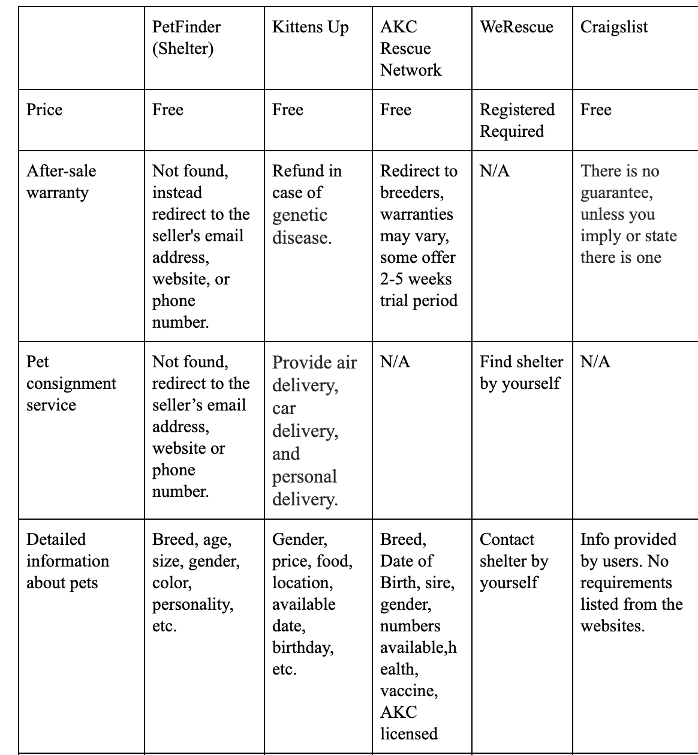
Proposed
Solution
Team 2
Fall 2021

Slide 4
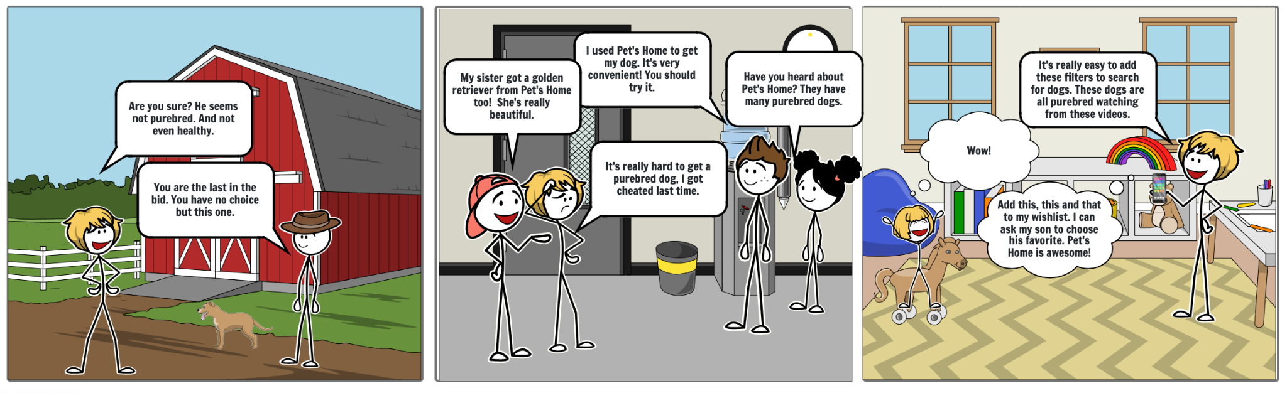
Visual Storyboard
Team 2
Fall 2021

Slide 5
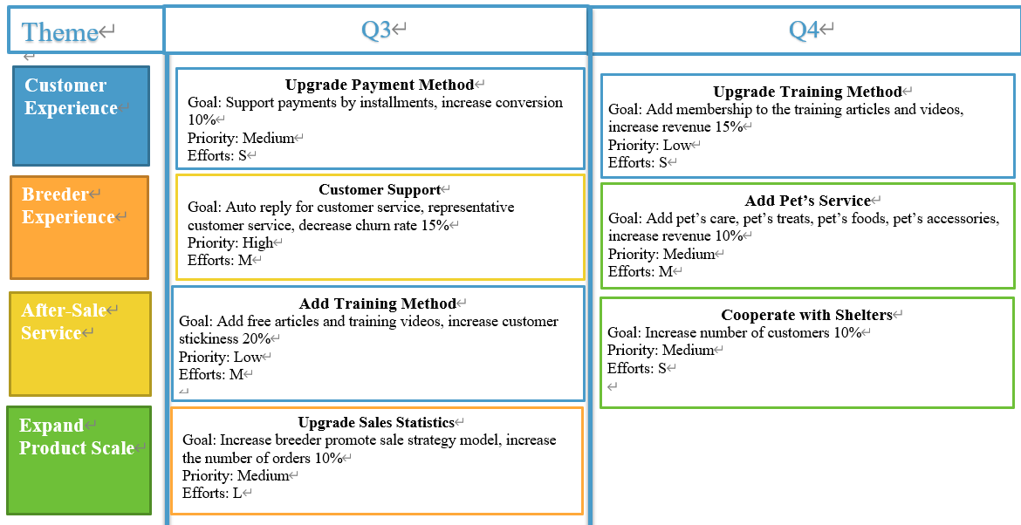
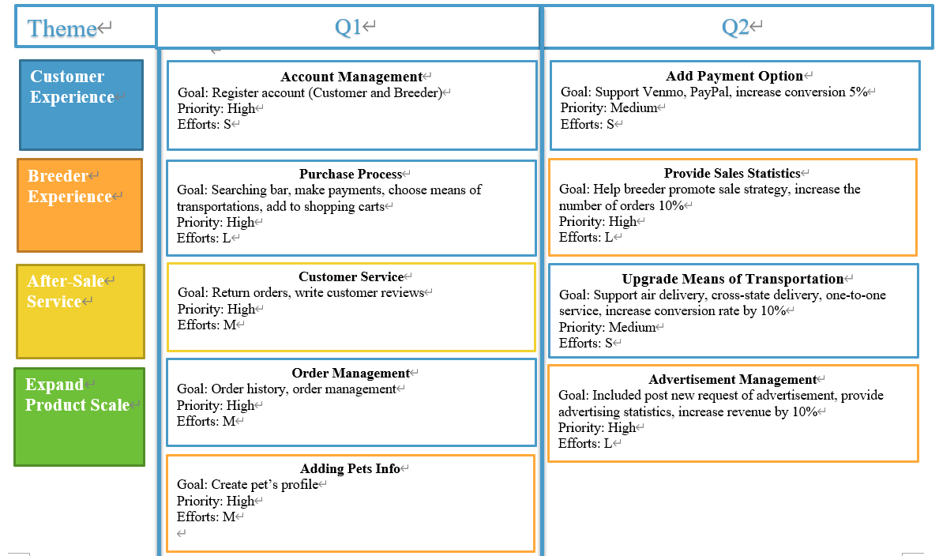
Roadmap Q1-Q4
Team 2
Fall 2021

Slide 6
Product Features
Team 2
One Click To Purchase
Nice To New Pets Owners
Verification
Multiple types of pets, transportation methods, after sale guarantees, customer support
Direct messages to breeders, useful articles and videos
Multiple credentials required for breeders, verification required for pets
Easy To Sell
Advertisement Support
Analyze Service Support
Easy to add pet’s profile, unique order process
Offer advertisement function to stay on the main page
Easy to review the useful data (page views, page view time, number of registered and guest customers…etc)
Fall 2021

Slide 7
Features of MVP for Launch
Team 2
Customer
Registration &
Profile
Search &
Browse
Cart &
Checkout
Order
management
Breeder
Registration &
Profile
Eligibility
verification
Pet
Management
Order
management
Fall 2021

Slide 8
Important Metrics
Team 2
01
02
03
Number of downloads
Average order value
Conversion rate
Number of people who visit our platform
how much customers typically spend on one single order
what rate people are purchasing products
04
05
06
Cart abandonment rate
Bounce rate
Average Session length
how many visitors are adding products to the shopping cart but are not checking out them
how many visitors leave your website after viewing only one page
average amount of time a visitor spends on the platform during the single visit
Fall 2021

Slide 9
Projected Costs
Team 2
Type
Development Cost
Marketing Cost
Legal advice Cost
Promotion fee
Customer Service
Detail
3 SDE
1 Test Engineer
1 UX Designer
Cloud Service
Lawyer Cost
Per month
$9022*3
$7217*1
$6744*1
$300
Total
$27,066*3
$7217 * 3
$6744 * 3
$300 * 3
$10,000
$5,000
$5,000
$ 123,981
$ 15,000
$ 5,000
Total projected cost : $143,981
Fall 2021

Slide 10
Team 2
Operational Needs
Application Development
Advertising & Promotion
Customer Support
A technical expert will be hired and cooperate with experienced UX design agency
Online: A social media expert will be hired
Offline: Local pet community promotion
Fully trained customer service team
Domestic Breeders
Pet Experts
Shipment Partnership
Attract more domestic breeders in early stage
Certification verification
Health condition support
Training articles & videos
Domestic Airlines
Local transportation Companies
Fall 2021

Slide 11

Addressing Risks
Privacy
Legal
Dependency
Competition
Team 2
Strict data viewing permission control
Store and encrypt personal information in a secure data center
Fully considering the policy for selling pets for different states or counties with professional legal team
Partnership with other companies for building transportation logistic network and supply chain for pets
Fully considering the customer’s needs and make the platform differentiate
Doing more usability tests and adjustments with the iterations of the platform
Fall 2021

